Slide 1
Chapter 18: Fourier Circuit Analysis
Part II

Slide 2
Outline
Complex Form of the Fourier Series
Definition of the Fourier Transform
Some Properties of the Fourier Transform
Fourier Transform Pairs for Some Simple Time Function
The Fourier Transform of a General Periodic Time Function
The System Function and Response in the Frequency Domain
The Physical Significance of the System Function

Slide 3
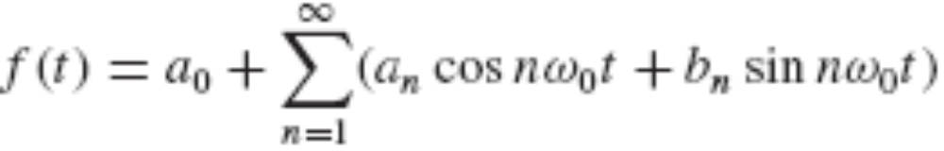
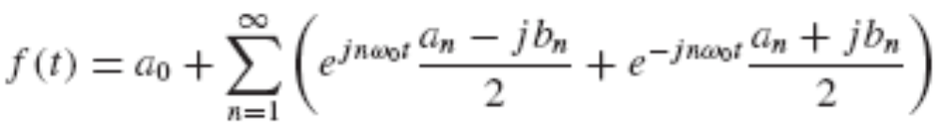
18.4 Complex Form of the Fourier Series
It is also possible to obtain the amplitude directly by using a form of Fourier series in which each term is a cosine function with a phase angle; the amplitude and phase angle are functions of f(t) and n.
An even more convenient and concise form of the Fourier series is obtained if the sines and cosines are expressed as exponential functions with complex multiplying constants.
The trigonometric form of the Fourier series:

Slide 4
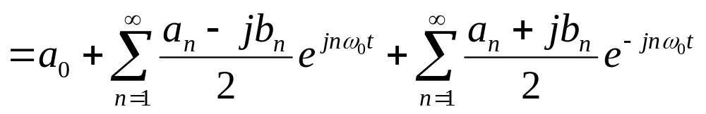
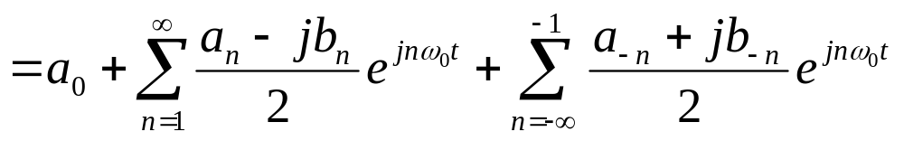

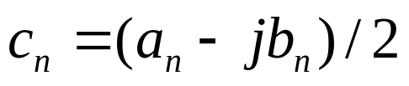



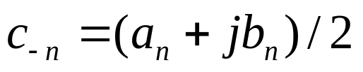
Define a complex constant c_{n}.
The values of a_{n}, b_{n}, and c_{n} all depend on n and f(t). By Eqs. [10] and [11], if f(t) is a real-valued function, it is evident that

Slide 5
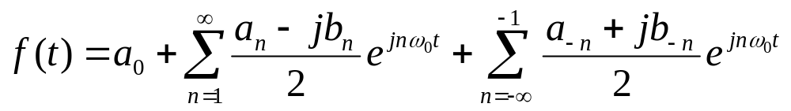
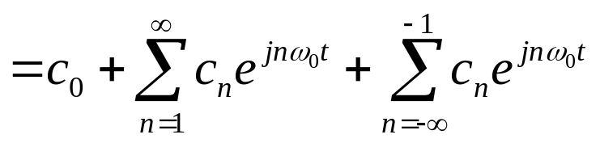


Let us sum over the negative integers from −1 to − ∞:
By agreement, a summation from −∞ to ∞ is understood to include a term for n = 0.

Slide 6

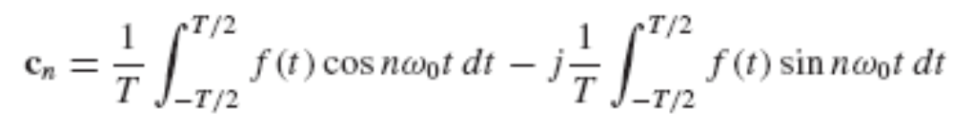
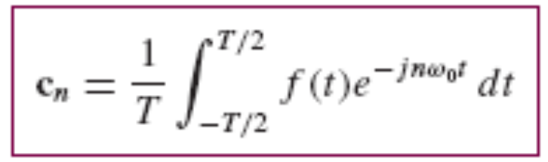

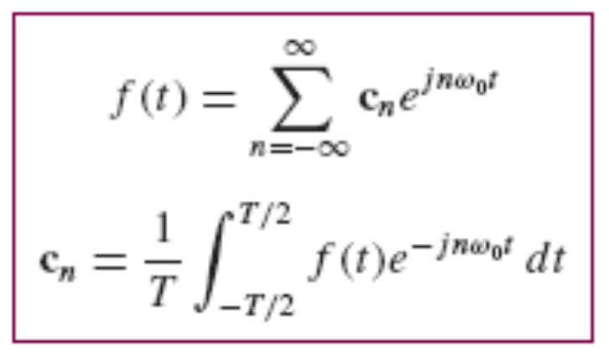
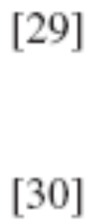
Equation [29] is the complex form of the Fourier series for f(t); Substitute Eqs. [10] and [11] in Eq. [27]:
Collecting the two basic relationships for the exponential form of the Fourier series,
where ω₀ = 2π/T as usual

Slide 7
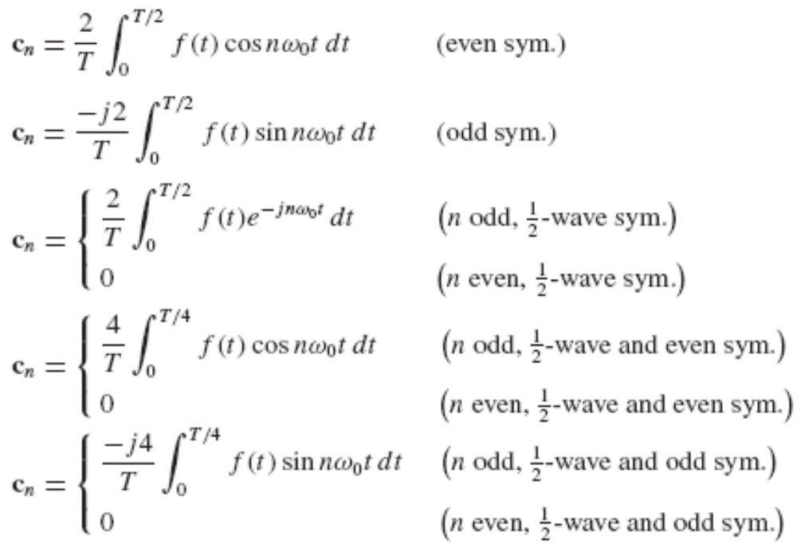
The amplitude of the component of the exponential Fourier series at ω = nω₀, where n = 0, ±1, ±2, … , is |c_{n}|.
Appropriate expressions for c_{n} are

Slide 8
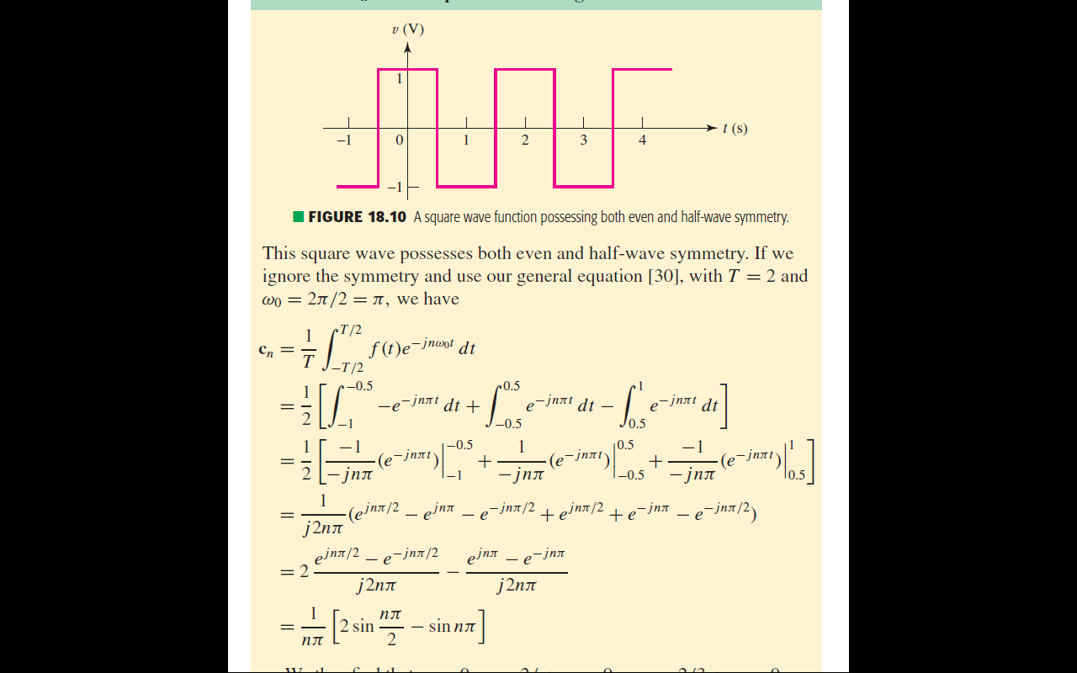
Example 18.3
Determine c_{n} for the square wave of Fig. 18.10.

Slide 10
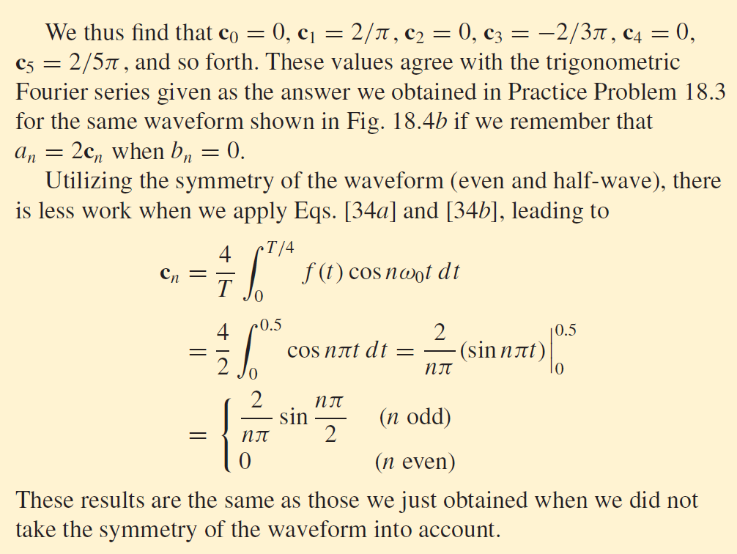
Example 17.1
Calculate shown in Fig 17.3.

Slide 11
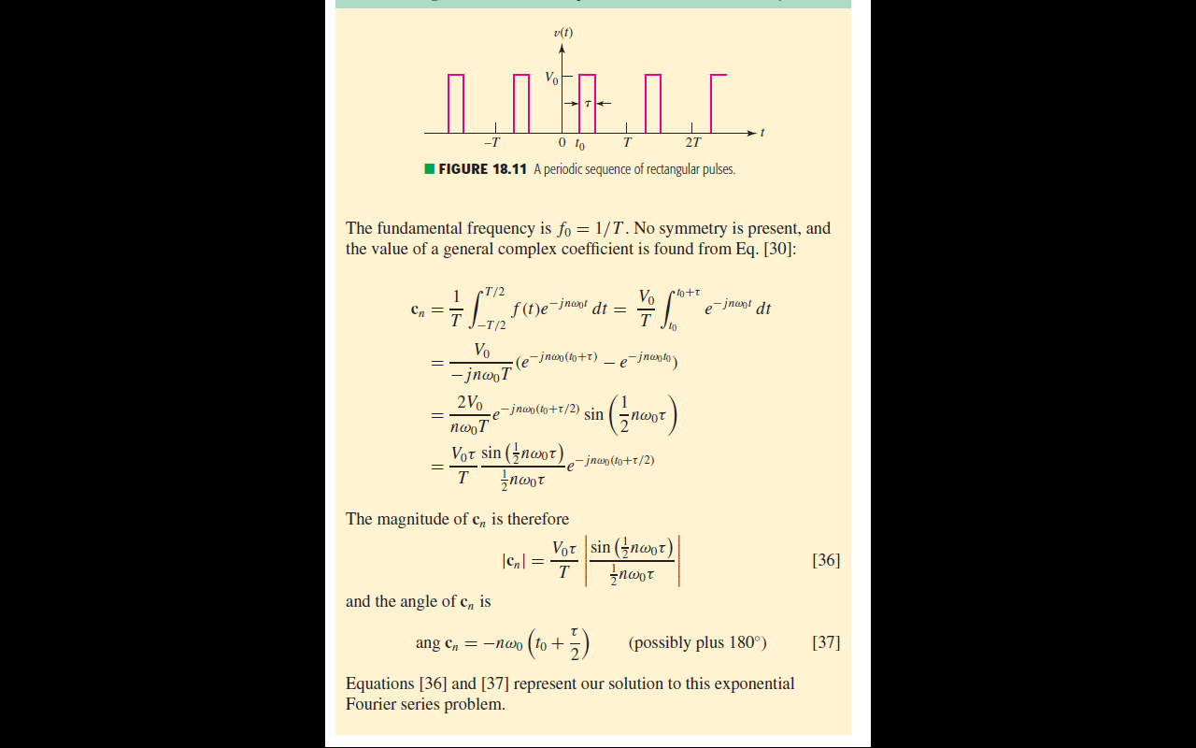
Example 18.4
A certain function f(t) is a train of rectangular pulses of amplitude V₀ and duration τ, recurring periodically every T seconds, as shown in Fig. 18.11. Find the exponential Fourier series for f(t).

Slide 13
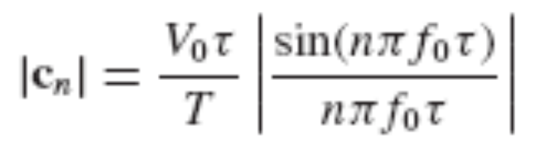
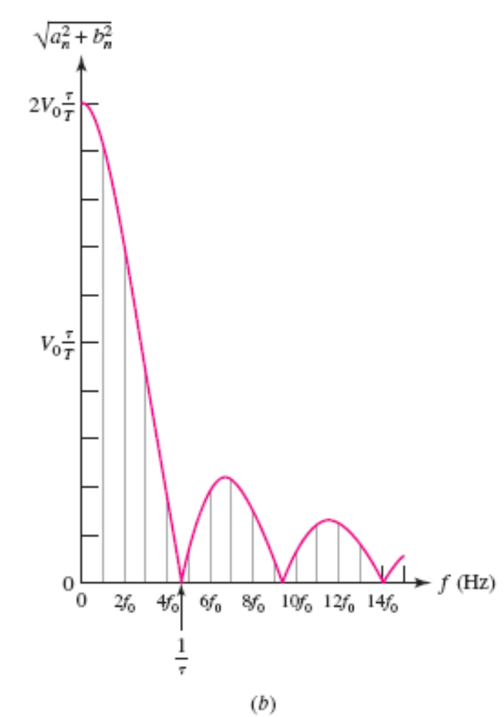
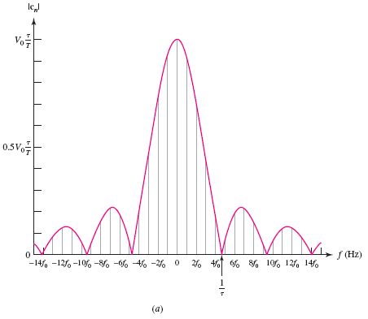
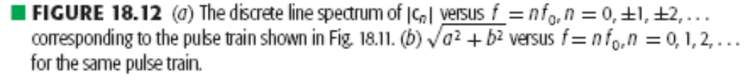

Slide 14


Sampling Function
The trigonometric factor in Eq. [36] occurs frequently in modern communication theory, and it is called the sampling function.
The “sampling” refers to the time function of Fig. 18.11 from which the sampling function is derived.
The product of this sequence of pulses and any other function f(t) represents samples of f(t) every T seconds if τ is small and V₀ = 1.
Sa(x) is zero whenever x is an integral multiple of π ; that is,

Slide 15
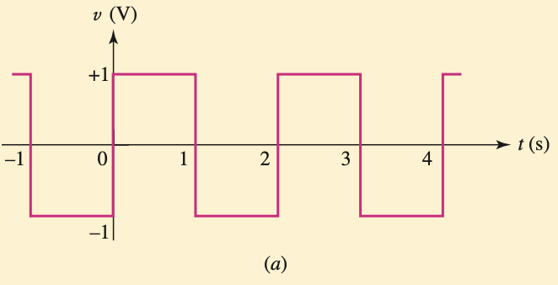
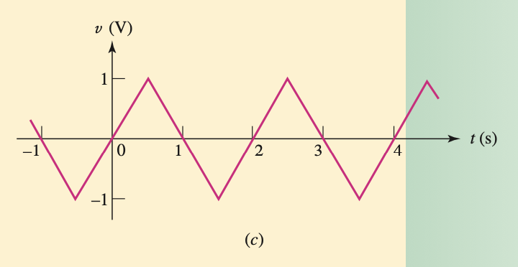
Practice 18.7
Determine the general coefficient c_{n} in the complex Fourier series for the waveform shown
(a) 18.4a;
(b) 18.4c;
Ans: – j2/(nπ) for n odd, 0 for n even;
– j [4/(n²π²)] sin (nπ)/2 for all n.

Slide 16
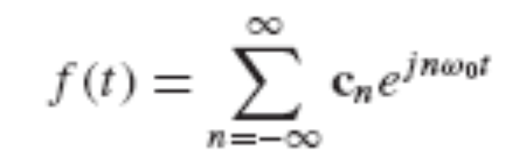

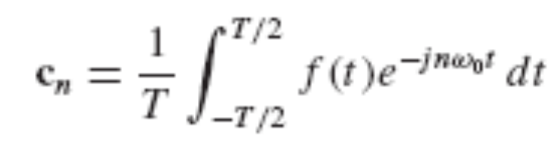



18.5 Definition of the Fourier Transform
The exponential form of the Fourier series:
Now let T → ∞ and thus, from Eq. [41], ω₀ must become vanishingly small.

Slide 17

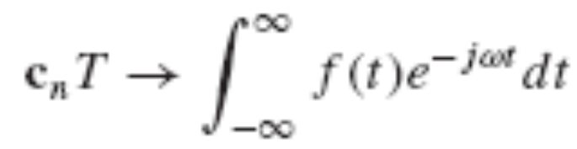
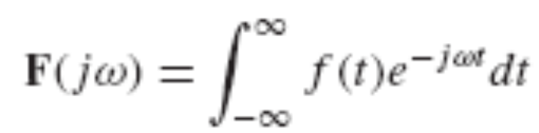
The frequency of any “harmonic” nω₀ must now correspond to the general frequency variable which describes the continuous spectrum. n must tend to infinity as ω₀ approaches zero, so that the product is finite:
If we multiply each side of Eq. [40] by the period T and then undertake the limiting process, a nontrivial result is obtained:
The right-hand side of this expression is a function of ω

Slide 18
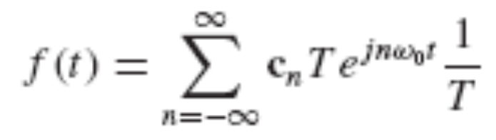
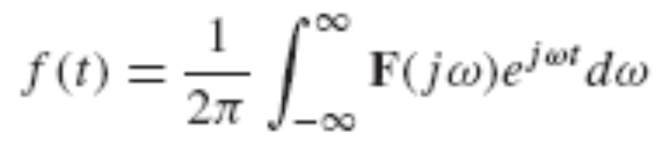
Apply the limiting process to Eq. [39]
next replacing c_{n}T with the new quantity F(jω), and then making use of expressions [42] and [43]
Equations [44] and [45] are collectively called the Fourier transform pair.
The function F(jω) is the Fourier transform of f(t), and f(t) is the inverse Fourier transform of F(jω).
This transform-pair relationship is most important!

Slide 19
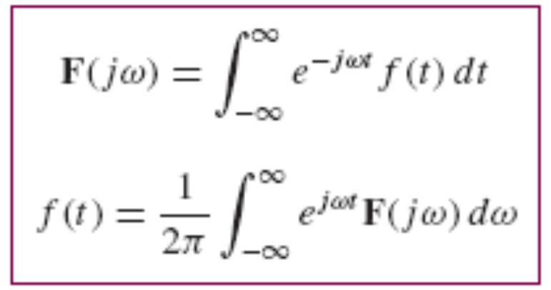
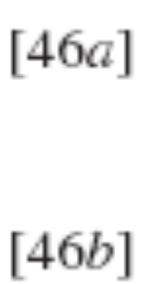

A sufficient condition for the existence of F(jω) is that
This condition is not necessary, because some functions that do not meet it still have a Fourier transform; the step function is one such example.

Slide 20
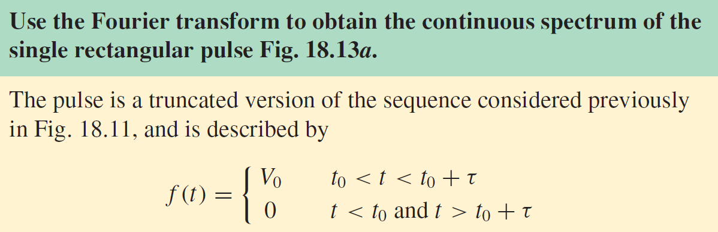
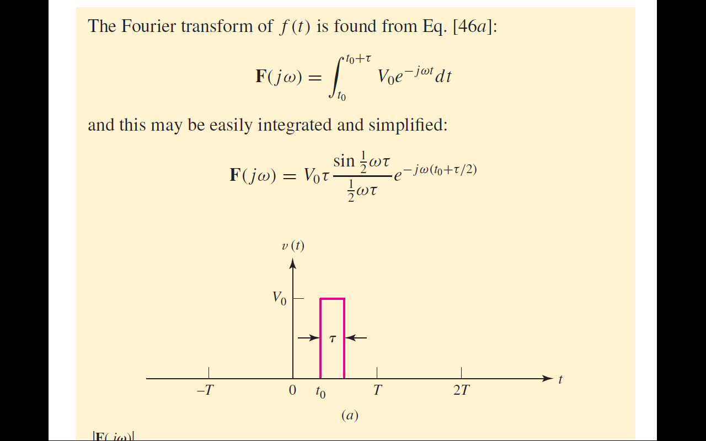
Example 18.5
Determine the general coefficient c_{n} in the complex Fourier

Slide 21
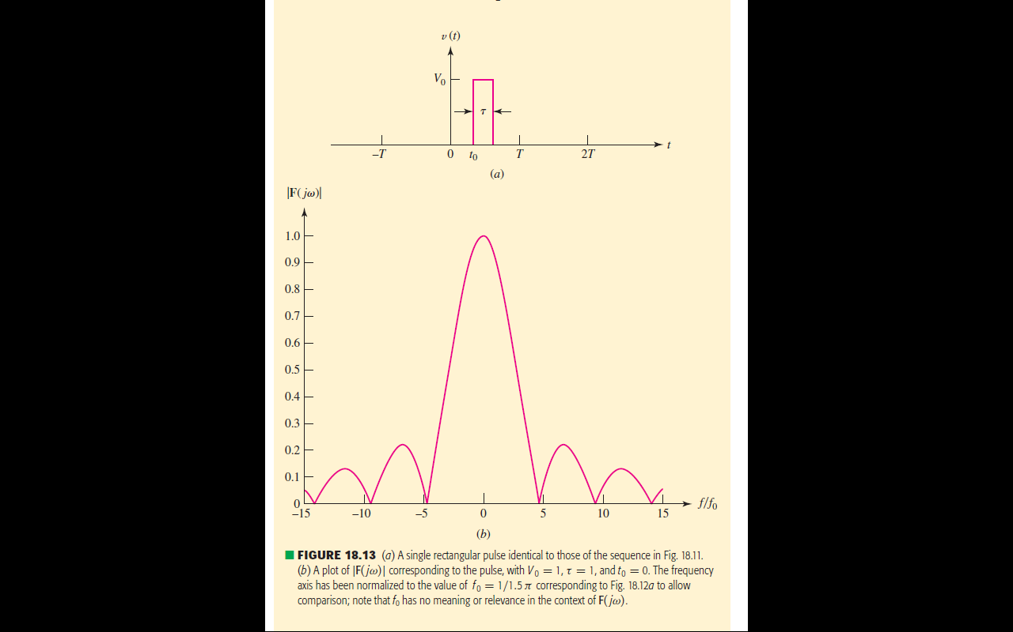
Example 18.5
Determine the general coefficient c_{n} in the complex Fourier

Slide 22
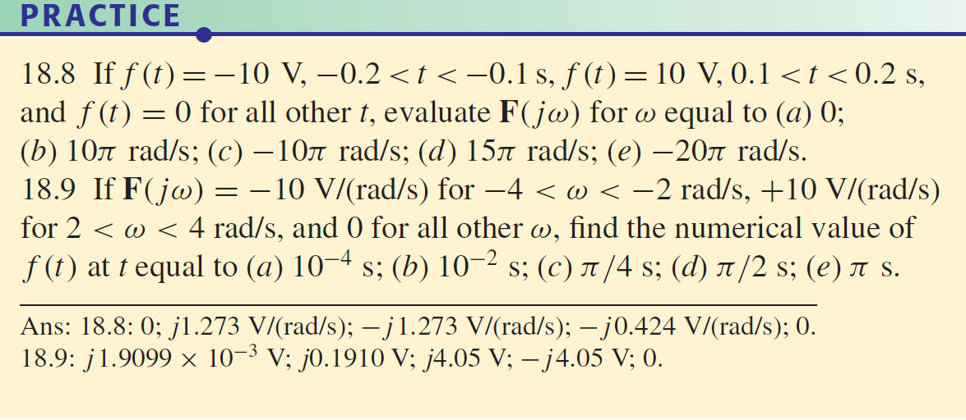
Example 18.5
Determine the general coefficient c_{n} in the complex Fourier

Slide 23
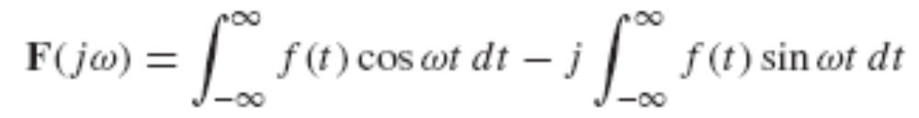

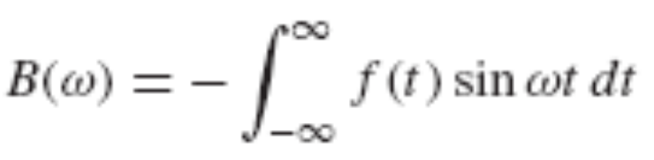
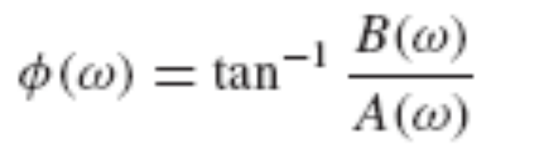
18.6 Some Properties of the Fourier Transform
By using Euler’s identity to replace e ^{– jωt} in Eq. [46a]:
Thus, by letting

Slide 24
Assuming f(t) is a real-valued function, replacing ω by − ω shows that
A(ω) and |F(jω)| are both even functions of ω,
while
B(ω) and φ(ω) are both odd functions of ω.

Slide 25
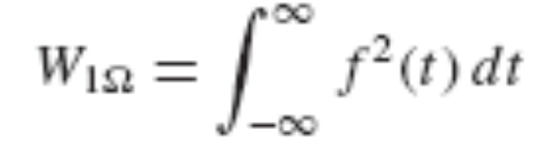

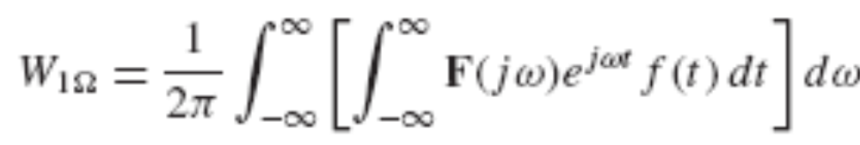
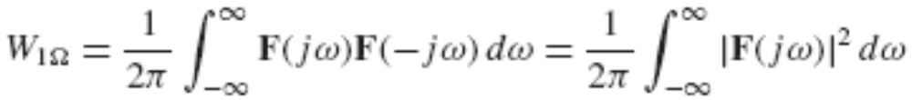
Physical Significant of Fourier Transform
Suppose that f(t) is either the voltage across or the current through a 1 Ω resistor, so that f ²(t) is the instantaneous power delivered to the 1 Ω resistor by f(t).
The total energy delivered by f(t) to the 1 Ω resistor,

Slide 26
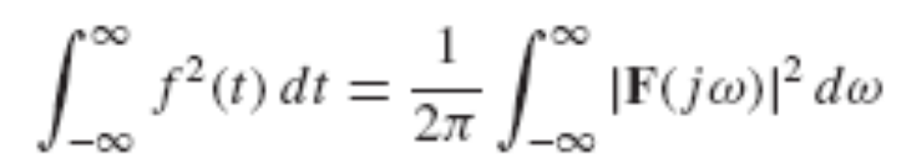

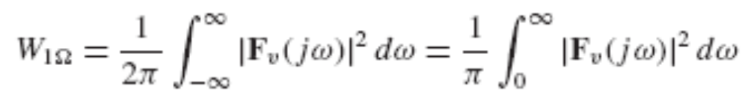
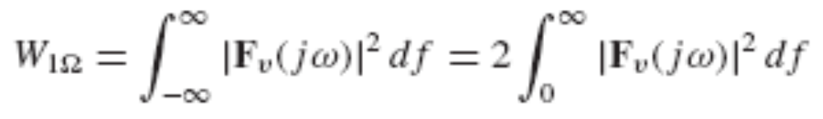
Equation [54] is a very useful expression known as Parseval’s theorem.
Consider a voltage v(t) with Fourier transform F_{v}(jω) and 1Ω energy W_{1Ω}:

Slide 27
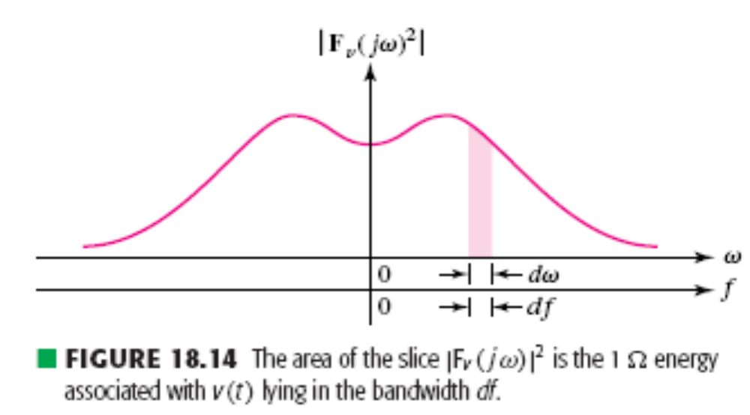
Figure 18.14 illustrates a typical plot of |F_{v}(jω)|² as a function of both ω and f.
|F_{v}(jω)|² is the (1Ω) energy density or energy per unit bandwidth (J/Hz) of v(t).
This energy density is always a real, even, nonnegative function of ω.

Slide 28
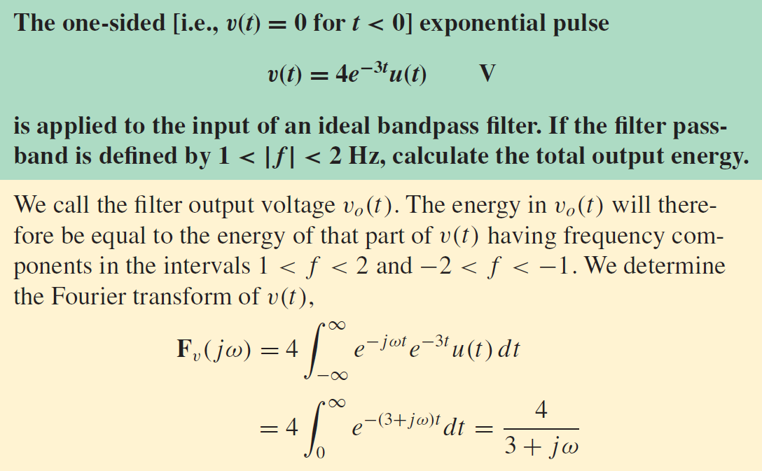
Example 18.6
Determine the general coefficient c_{n} in the complex Fourier

Slide 29
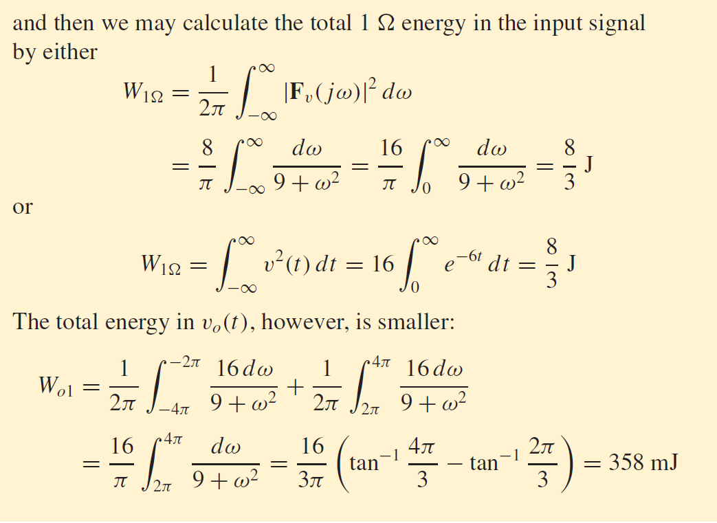
Example 18.6
Determine the general coefficient c_{n} in the complex Fourier

Slide 30
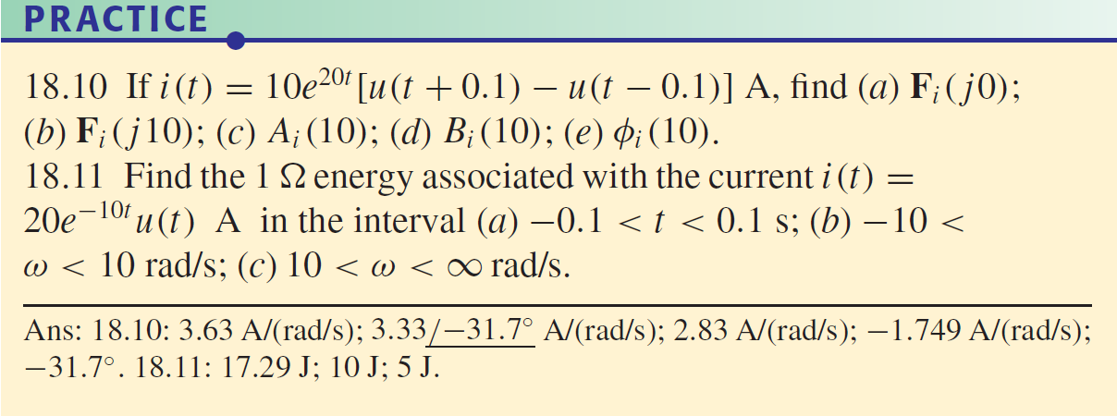
Example 18.6
Determine the general coefficient c_{n} in the complex Fourier

Slide 31
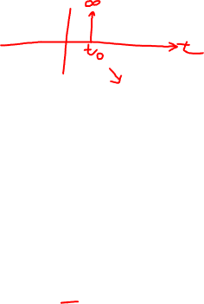
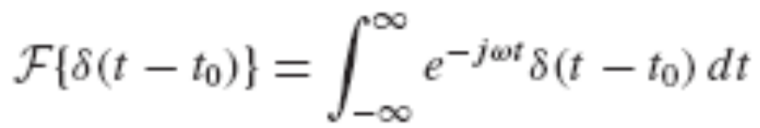
18.7 Fourier Transform Pairs for some Simple
Time Functions
Unit Impulse Function
We now seek the Fourier transform of the unit impulse δ (t − t₀). If we use the notation F{ } to symbolize “Fourier transform of
{ },” then
This complex function of ω leads to the 1 energy-density function,
This remarkable result says that the (1Ω) energy per unit bandwidth is unity at all frequencies, and that the total energy in the unit impulse is infinitely large.

Slide 32
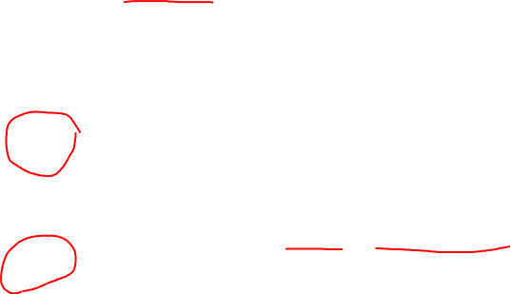




Consider a Fourier transform in that form,
which is a unit impulse in the frequency domain located at ω = ω₀.
Also,
Clearly, the time function is complex in both expressions [57] and [58], and does not exist in the real world of the laboratory

Slide 33

The frequency-domain description of cos ω₀t shows a pair of impulses, located at ω = ± ω₀.

Slide 34





The Signum Function
Let us obtain the Fourier transform of a singularity function known as the signum function, sgn(t), defined by

Slide 35


The Unit Step Function

Slide 36


Slide 38



Slide 39






Slide 40

Example 18.7
Determine the general coefficient c_{n} in the complex Fourier

Slide 41
Example 18.7
Determine the general coefficient c_{n} in the complex Fourier

Slide 42







18.8 The Fourier Transform of a General
Periodic Time Function
Consider a periodic time function f(t) with period T and Fourier series expansion,

Slide 43



f(t) has a discrete spectrum consisting of impulses located at points on the ω axis given by ω = nω₀, n = …,−2,−1, 0, 1, …
The strength of each impulse is 2π times the value of the corresponding Fourier coefficient appearing in the complex form of the Fourier series expansion for f(t).
This inverse transform
which is exactly the same as Eq. [39], the complex Fourier series expansion for f(t).

Slide 44


Example 18.7
Determine the general coefficient c_{n} in the complex Fourier

Slide 45



18.9 The System Function and Response in the
Frequency Domain
Assuming arbitrarily that the input and output are voltages, we apply the basic definition of the Fourier transform and express the output by the convolution integral:
where we again assume no initial energy storage.

Slide 46


Simplify the integration with respect to t by a change of variable,
t − z = x:
This is another important result: it defines the system function H(jω) as the ratio of the Fourier transform of the response function to the Fourier transform of the forcing function.

Slide 47

The Fourier transform of the convolution of two time functions is the product of their Fourier transforms,

Slide 48

Example 18.8
Calculate the input impedance for the one-port resistor network shown in Fig 17.3.

Slide 49


18.10 The Physical Significance of the System
Function
Given a general linear two-port network N without any initial energy storage, we assume sinusoidal forcing and response functions, arbitrarily taken to be voltages, as shown in Fig. 18.21.
We let the input voltage be simply A cos(ω_{x}t +θ), and the output can be v_{o}(t) = B cos(ω_{x}t +φ), where the amplitude B and phase angle φ are functions of ω_{x}.
In phasor form, V_{i} = A e ^{jθ} and V_{o} = B e ^{jφ}.

Slide 50

For the circuit with sinusoidal input and output shown in Fig. 18.21, what is the system function H(jω)?
To answer this question, we begin with the definition of H(jω) as the ratio of the Fourier transforms of the output and the input.
Consider

Slide 51



Make the substitution ω_{x}t +β = ω_{x}τ  t = τ – β /ω_{x}

Slide 52


where B and φ were evaluated at ω = ω_{x} , and we see that evaluating H(jω) at ω = ω_{x} gives
The system function and the transfer function are identical:
Our previous work on steady-state sinusoidal analysis using phasors was but a special case of the more general techniques of Fourier transform analysis.

Slide 53

Example 18.8
Find the voltage across the inductor of the circuit shown in Fig. 18.22a when the input voltage is a simple exponentially decaying pulse, as indicated.

Slide 54

Example 18.8
Calculate the input impedance for the one-port resistor network shown in Fig 17.3.

Slide 55

Example 18.8
Calculate the input impedance for the one-port resistor network shown in Fig 17.3.

Slide 56

Example 18.8
Calculate the input impedance for the one-port resistor network shown in Fig 17.3.

